Slide 1
Beijing Air Pollution Time Series By: Michael Rozenvasser

Slide 2
DATA
Beijing Air Quality Dataset
2010-2015
About 1500 rows, 9 columns
Changed column names when importing as well as turned hourly measurements of features into averages
Dropped categorical feature named wind_dr
Notes:
We do this becuase it provides us with a useful abstract model for thinking about the time series data. Naturally the Beijing Air Pollution dataset after our manipulations is not stationary, meaning the mean, variance, and covariance will be time dependent. We must identify and seperate trends and seasonality from time series data before applying a model

Slide 3
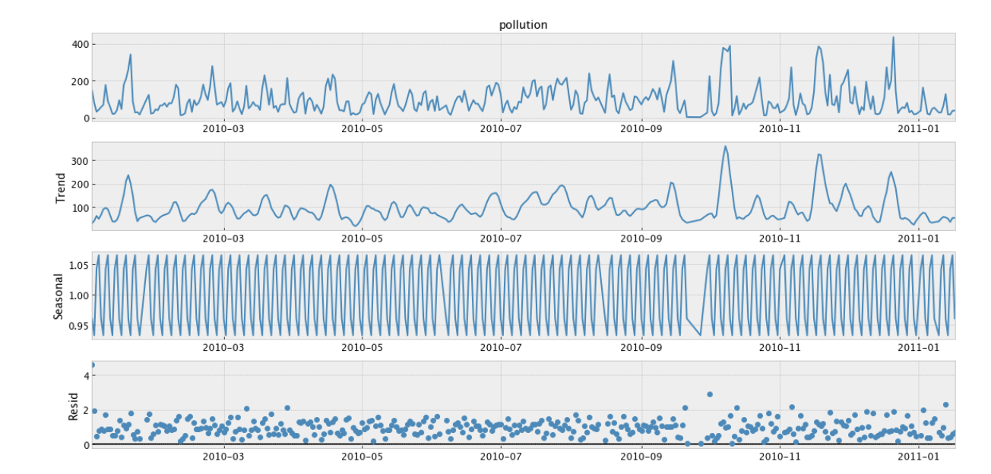
EDA
Focused on:
Level
Trend
Seasonality
Noise Components
Notes:
We do this becuase it provides us with a useful abstract model for thinking about the time series data. Naturally the Beijing Air Pollution dataset after our manipulations is not stationary, meaning the mean, variance, and covariance will be time dependent. We must identify and seperate trends and seasonality from time series data before applying a model

Slide 4
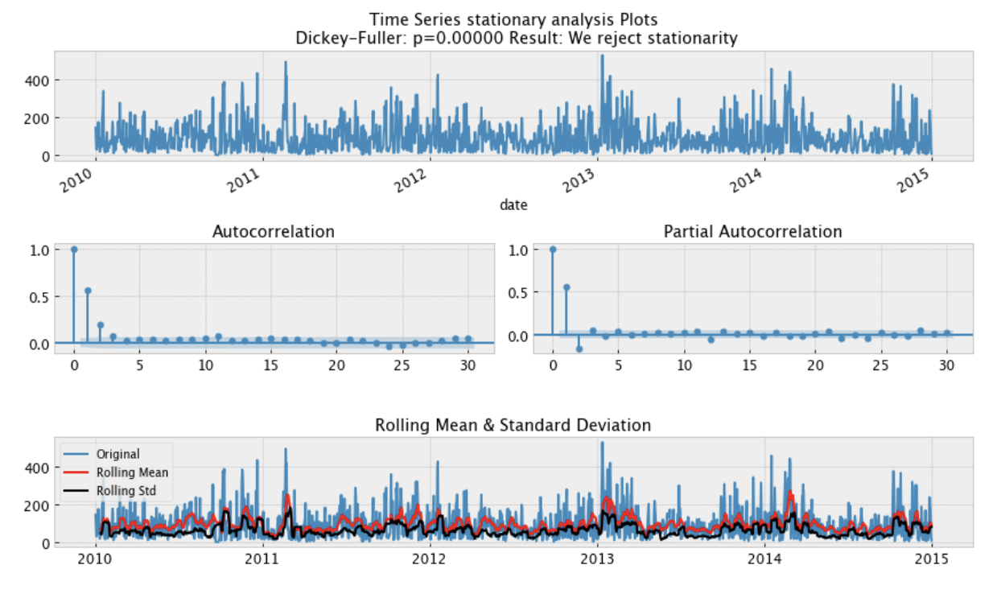
EDA

Slide 5
Results
Models Tested:
Autoregression (AR)
Autoregressive Moving Average(ARMA)
Autoregressive integrated moving average (ARIMA)
Seasonal autoregressive integrated moving average (SARIMA)
XGBoost
Lightgbm
Prophet
DeepAR
Notes:
We do this becuase it provides us with a useful abstract model for thinking about the time series data. Naturally the Beijing Air Pollution dataset after our manipulations is not stationary, meaning the mean, variance, and covariance will be time dependent. We must identify and seperate trends and seasonality from time series data before applying a model

Slide 6
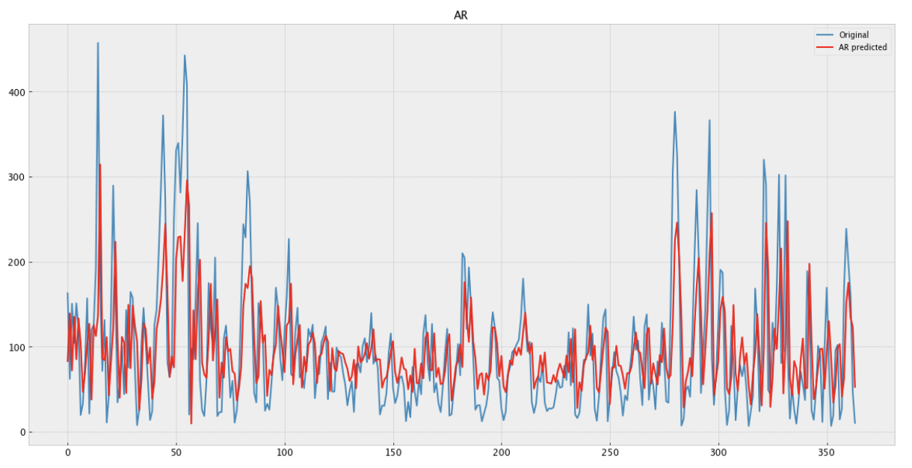
AR

Slide 7
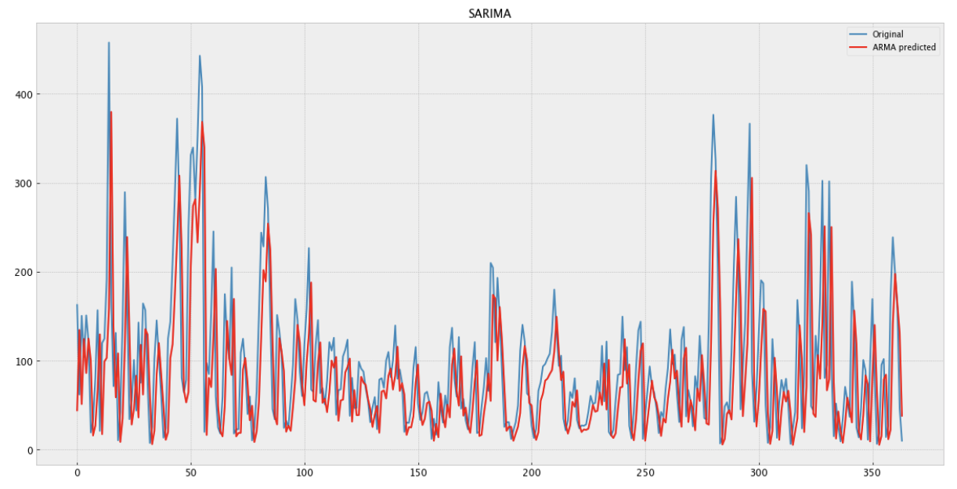
Seasonal Autoregressive Integrated Moving-Average (SARIMA)

Slide 8
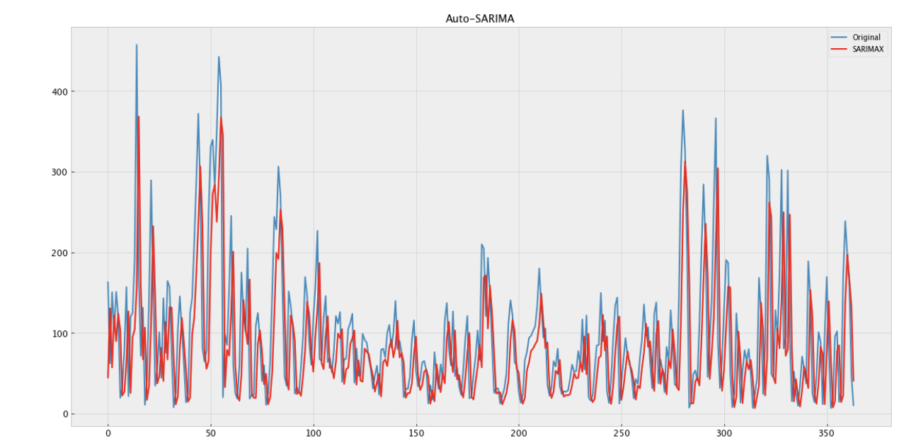
Auto SARIMA

Slide 9
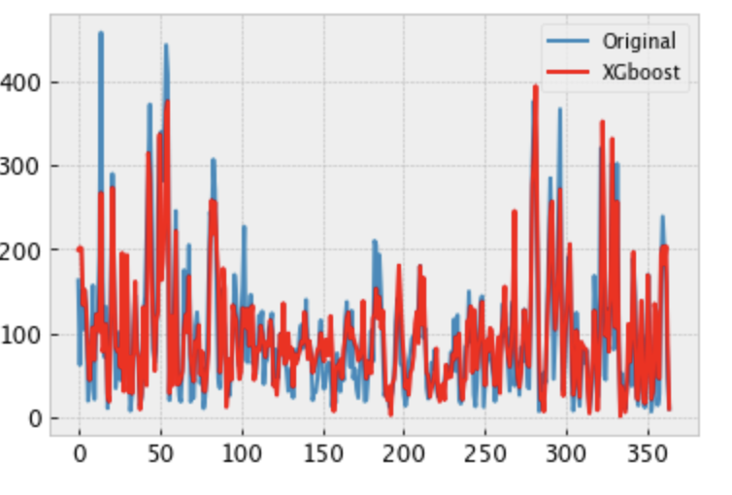
Linear Model - XGBOOST

Slide 10
Best Model
Deep AR – The worst
MAE – 72
RMSE- 105
Lightgbm
Mae - 30
RMSE - 43

Slide 11
Conclusion
Most models that used extra features, performed better.
Always perform extensive stationarity checks as it will help choose which models you want to use.
Model called N-BEATS, Neural basis expansion analysis for interpretable time series forecasting

